Slide 1
The 5 Principles of Responsible
Purchasing
Better Buying’s new e-learning course

Slide 2
The Gold Standard in responsible purchasing training
Whole company approach
Informed by Better BuyingTM research and supplier data gathered over five ratings cycles
Endorsed by leading global brands and retailers
Special rates for Better BuyingTM subscribers
Notes:
Logos are for holding purposes only prior to asking formal permission - not sure if they are even the right ones!

Slide 3
What will you learn?
The Five Principles of Responsible PurchasingTM:
Visibility, Stability, Time, Financials, and Shared Responsibility
How your decisions affect different levels of the supply chain
How to challenge existing processes and work with colleagues to identify new ones that work for everyone

Slide 4
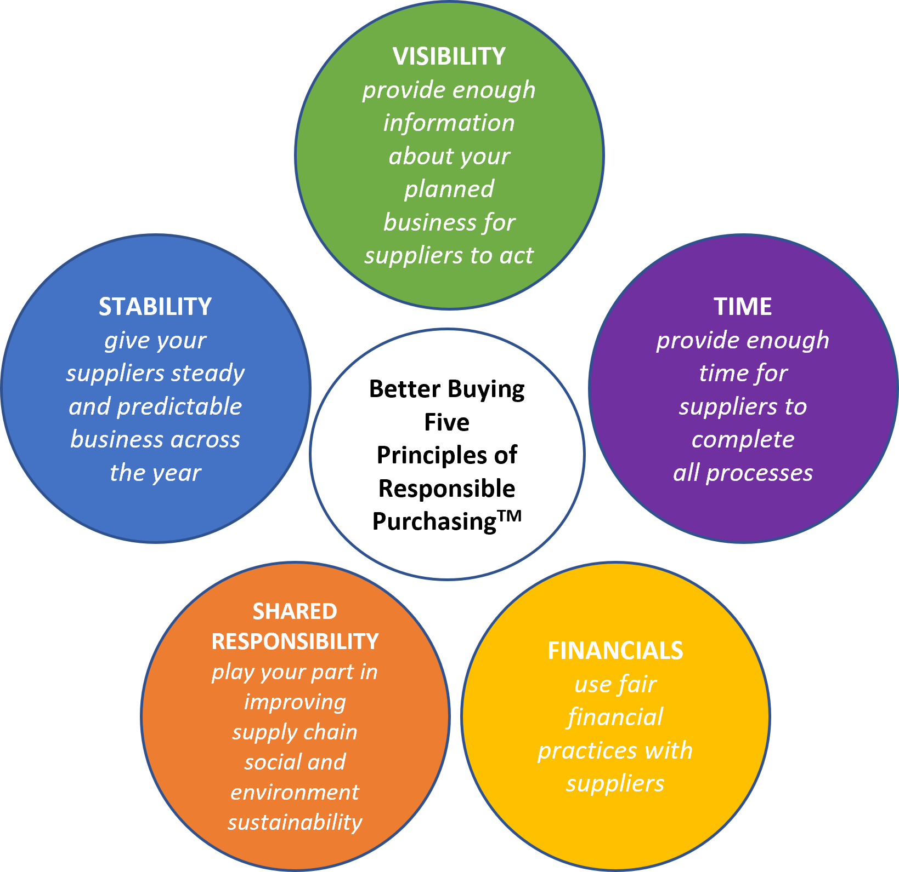
Learn what adherence to the Five Principles looks like
Better able to understand stakeholder pressures, company commitments and internal policies
Improved awareness of how your decisions affect the supply chain, specifically suppliers, workers and the environment
Empowered to challenges existing processes and work together to identify new processes that better support improved purchasing practices

Slide 5
Essential insights for your employees on:
The impacts to your business of not following the Five Principles
For Suppliers
Management stress* Shortage of workers* Unauthorized subcontracting* Overcapacity or idle lines
For Workers
Reduced hours or pay* Safety risks* Forced labor* Harassment

Slide 6
Whole-company training
Suitable for companies in multiple sectors: apparel; footwear; softgoods; hardgoods; homegoods, consumer goods
Everyone in the company - buying; CSR; design; product development; finance; human resources; C-suite
Labour inspectors; auditors; manufacturing groups; logistics and distribution; students at fashion colleges and universities.

Slide 7
How integrating the Five Principles into your
business can benefit you
Reduced cycle times
More accurate demand timing
More predictable lead times
A more effective workforce and factory utilization
Better product quality
Lower costs
Improved social and environmental performance
Improved accountability to investors and stakeholders

Slide 8
To discuss how to register your company for
Better Buying’s e-learning course, contact:
Leonie.Abraham@betterbuying.org

